Slide 1
Unit 1 Review
Integrity
Availability
Information Security
Confidentiality

Slide 2
Due Diligence vs. Due Care
Due Care
What a reasonable person would do in a given situation.
Due Diligence
The management of due care.

Slide 3
3. To prevent any one person from having too much control or power, or performing fraudulent acts, which of the following solutions should NOT be implemented?
M of N control
Job rotation
Multiple key pairs
Separation of duties
Answer: B

Slide 4
7. Which item is not a part of the primary security categories?
Prevention
Encryption
Detection
Recovery
Answer: B

Slide 5
8. Which of the following is a nontechnical means of enforcing security?
Development of a disaster response plan
Separation of duties
User training
Safe testing
Answer: C

Slide 6
15. Which of the following types of controls restricts access based on time?
Temporal time restriction
Date restriction
Time of day restriction
Authorized access hours
Answer: C

Slide 7
17. Which of the following is a security program used in many banks to verify the ethics and job performance of a bank manager?
Ethical investigation
Mandatory vacation
Mandatory cruise
M of N
Answer: B

Slide 8
Risk Identification, Monitoring, and Analysis

Slide 9
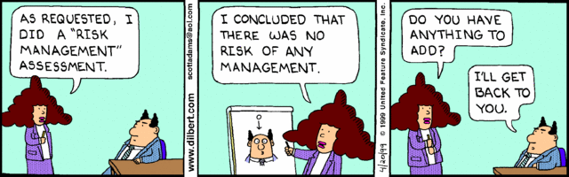

Slide 10
Domain Objectives
Describe the risk management process
Perform security assessment activities
Describe processes for operating and maintaining monitoring systems
Identify events of interest
Describe the various source systems
Interpret reporting findings from monitoring results

Slide 11
Risk Management Concepts
The ultimate purpose of information security is to reduce risks to acceptable levels
The cost of controls should never exceed the loss

Slide 12
Key Terms
Risk
Likelihood
Threat source
Threat
Vulnerability
Impact
Asset

Slide 13
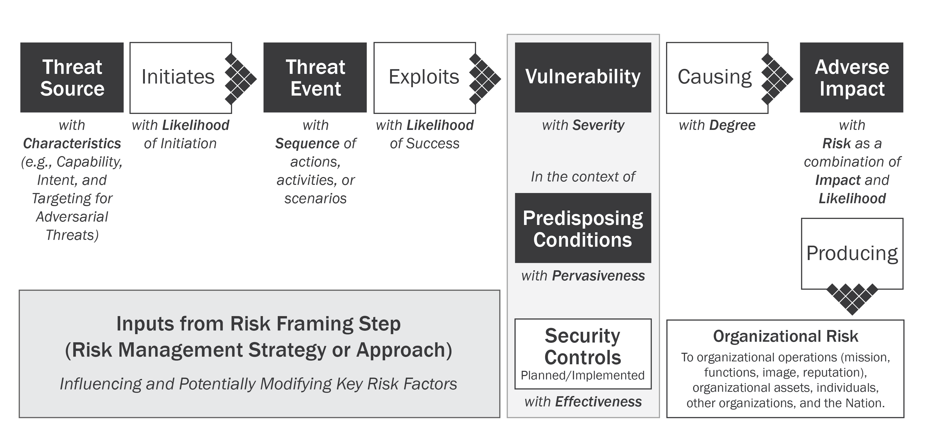
Generic Risk Model with Key Factors – NIST SP 800-30 R1

Slide 14
Risk Assessment
Risk assessments evaluate threats to information systems, system vulnerabilities and weaknesses, and the likelihood that threats will exploit these vulnerabilities and weaknesses to cause adverse effects

Slide 15
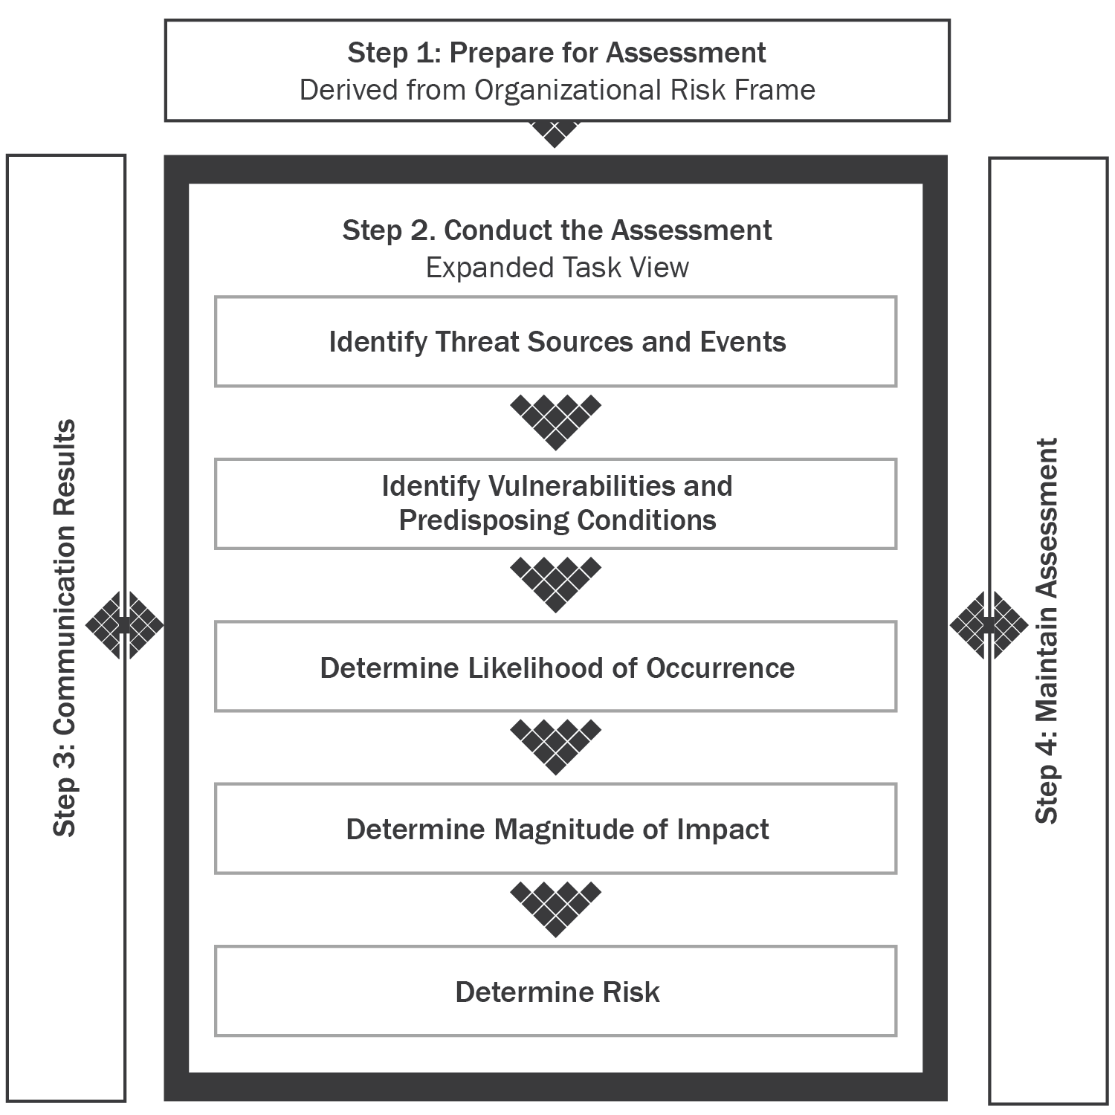
NIST SP 800-30 R1 Risk Assessment Methodology

Slide 16
Step 1. Prepare for the Assessment
Objective:
Establish a context for the risk assessment
This context is established and informed by the results from the risk-framing step of the risk management process

Slide 17
Preparation Steps
Identify the purpose of the assessment
Identify the scope of the assessment
Identify the assumptions and constraints associated with the assessment
Identify the sources of information to be used as inputs to the assessment
Identify the risk model and analytic approaches

Slide 18
Risk Assessment Steps
Identify threat sources
Identify threat events
Identify vulnerabilities
Determine the likelihood of threats
Determine the adverse impacts
Determine information security risks

Slide 19
Step 2a. Identify Threat Sources
Identify potential threats to information resources

Slide 20
Step 2b. Identify Potential Threat Events
Threat events are characterized by the threat sources that could initiate the events
Define these threat events with sufficient detail to accomplish the purpose of the risk assessment

Slide 21
Step 2c. Identify Vulnerabilities and Predisposing Conditions
Identify technical and nontechnical vulnerabilities that, if exploited, could result in a compromise of system or data confidentiality, integrity, and/or availability

Slide 22
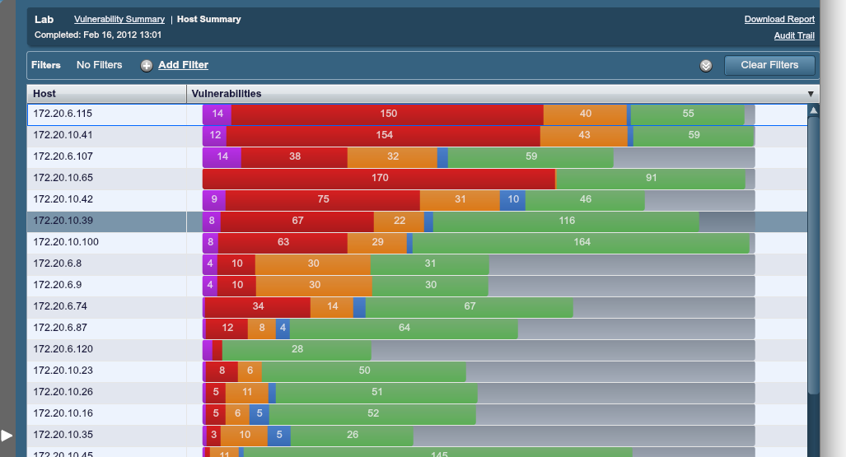
Commercial Tools

Slide 23
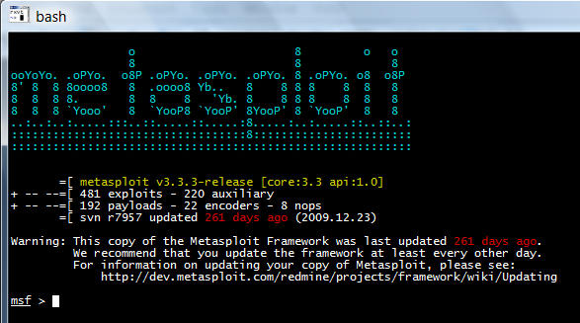
Metasploit Console

Slide 24
Step 2d. Determine Likelihood
Factors that must be considered:
The nature of the vulnerability
The threat source’s motivation and capability
The effectiveness of controls

Slide 25
Step 2e. Determine Impact
An impact analysis cannot be performed until system mission, system and data criticality, and system and data sensitivity have been obtained and assessed

Slide 26
Step 2f. Risk Determination
Risk determination results from the combination of:
The likelihood of a threat source attempting to exploit a specific vulnerability
The magnitude of the impact that would result if an attempted exploit were successful
The effectiveness of existing and planned security controls in reducing risk

Slide 27
Step 3. Communicating and Sharing Risk Assessment Information
Communicating and sharing information consists of:
Communicate the risk assessment results
Share information developed in the execution of the risk assessment to support other risk management activities

Slide 28
Step 4. Maintaining the Risk Assessment
Maintaining risk assessments includes the following specific tasks:
Monitor risk factors identified in risk assessments
Update the components of risk assessments

Slide 29
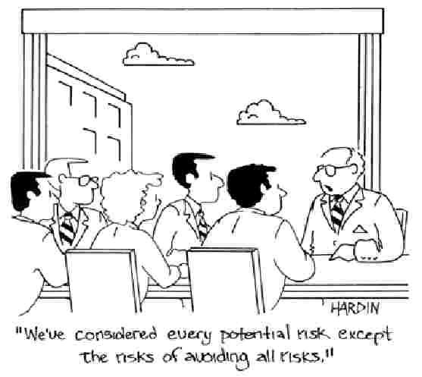

Slide 30
Important Formulas
Single Loss Expectancy = Asset Value X Exposure Factor
Annual Loss Expectancy = Single Loss Expectancy X Annualized Rate of Occurrence
Annualized Rate of Occurrence

Slide 31
Quantitative Analysis
A quantitative impact analysis assigns a dollar value to the impact

Slide 32
Qualitative Analysis
A qualitative impact analysis assesses impact in relative terms such as high impact, medium impact, and low impact without assigning a dollar value to the impact

Slide 33
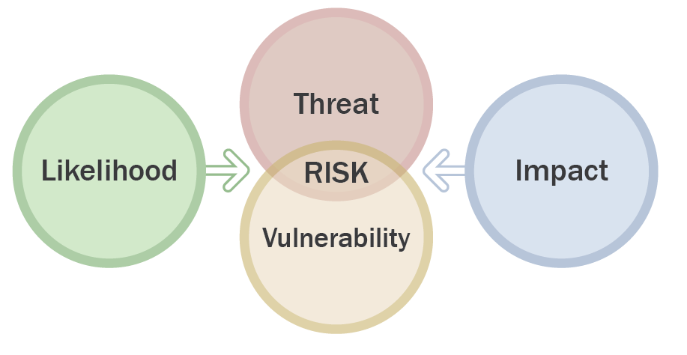
Risk-Level Matrix
A risk-level matrix can be created that analyzes the combined impact of these factors to assess the overall risk to a given IT system
 | IMPACT
Threat Likelihood | Low (10) | Moderate (50) | High (100)
High (1.0) | 10 x 1.0 = 10 | 50 x 1.0 = 50 | 100 x 1.0 = 100
Moderate (0.5) | 10 x 0.5 = 5 | 50 x 0.5 = 25 | 100 x 0.5 = 50
Low (0.1) | 10 x 0.1 = 1 | 50 x 0.1 = 5 | 100 x 0.1 = 10
Risk Scale: High (>50 to 100) Moderate (>10-50) Low (1 to 10)

Slide 34
Risk Treatment
Risk mitigation
Risk transference
Risk avoidance
Risk acceptance

Slide 35
Risk Mitigation
Risk mitigation reduces risks to the organization by implementing technical, managerial, and operational controls
Controls should be selected and implemented to reduce risk to acceptable levels

Slide 36
Control Selection
The key to control selection is to implement cost-effective controls that reduce or mitigate risks to levels that are acceptable to the organization
Managerial
Technical
Operational

Slide 37
Residual Risk
Residual risk:
The risk that remains after risk reduction and mitigation efforts are complete
Organizations must determine how to treat this residual risk

Slide 38
Risk Transference
Risk transference transfers risk from an organization to a third party
Most common method is insurance
Some risk cannot be transferred

Slide 39
Risk Avoidance
Risk can be avoided by eliminating the entire situation causing the risk
Disabling system functionality
Preventing risky activities when risk cannot be adequately reduced

Slide 40
Risk Acceptance
A risk acceptance strategy indicates that an organization is willing to accept the risk associated with the potential occurrence of a specific event

Slide 41
Audit Methodologies
ISO/IEC 27001:2013
ISO/IEC 27002:2013
NIST SP 800-37 R1
COBIT

Slide 42
Auditor Responsibilities
Provide independent assurance to management that security systems are effective
Analyze the appropriateness of organizational security objectives
Analyze the appropriateness of policies, standards, baselines, procedures, and guidelines that support security objectives
Analyze the effectiveness of the controls that support security policies
State and explain the scope of the systems to be audited

Slide 43
Perform Security Assessment Activities

Slide 44
Vulnerability Scanning and Analysis
Vulnerability scanning is simply the process of checking a system for weaknesses
Benefits:
Identifies system vulnerabilities
Allows for the prioritization of mitigation tasks
Useful tool for comparing security posture over time
Disadvantages:
It may not effectively focus efforts
Potential to crash the network

Slide 45
Potential Problems
False positives
Weeding out false positives
Crash exposure
Temporal information

Slide 46
Security Gateway Types
Antivirus gateways
Java/ActiveX filters
Web traffic screening

Slide 47
Penetration Testing
Phase 1: Preparation
Phase 2: Information gathering
Phase 3: Information evaluation and risk analysis
Phase 4: Active penetration
Phase 5: Analysis and reporting

Slide 48
Penetration Testing Modes
White box
Gray box
Black box

Slide 49
Social Engineering and Low-Tech Reconnaissance
Social engineering involves the manipulation of people or physical reconnaissance to get information
Low-tech reconnaissance uses simple technical means to obtain information

Slide 50
Basic Built-in Tools
Traceroute (Windows calls this tracert)
Ping
Telnet
Whois
System Fingerprinting

Slide 51
Understanding Network Behavior
Source address allows the understanding of who is originating the traffic
Destination address tells who is receiving the traffic
Ports characterize the application utilizing the traffic
Class of service examines the priority of the traffic
The device interface tells how traffic is being utilized by the network device
Tallied packets and bytes show the amount of traffic

Slide 52
Monitoring Terminology
Safeguard
Countermeasure
Vulnerability
Exploit
Signature
False positive
False negative
True positive
True negative
Tuning
Promiscuous interface

Slide 53
Types of IDS/IPS Devices
Network-based IDS (NIDS)
Host-based IDS (HIDS)

Slide 54
Intrusion Detection System (IDS)/ Intrusion Prevention System (IPS)
Intrusion detection
Detection of malicious activity in a computer related system
These malicious activities or intrusions are interesting from a computer security perspective

Slide 55
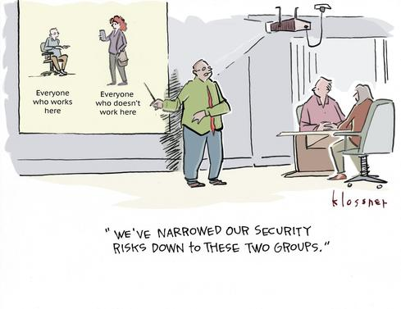

Slide 56
Attackers
Attackers are threats generally thought of as people who perform overt and covert intrusions or attacks on systems

Slide 57
Attacker Motivations
Notoriety, ego, or sport
Greed and profit
Political agenda
Revenge
Curiosity

Slide 58
Intrusions
Intrusions are acts by persons, organizations, or systems that violate the security framework of the recipient
Overt
Covert

Slide 59
Logging
What devices and hosts might contain critical log data
What information gets logged
Where and how the log files are going to be stored
Retention schedule for log files
What security measures are going to be employed to ensure the integrity of the log files in storage and in transit
Who has access to modify or delete log files

Slide 60
Reviewing Host Logs
Auditors are going to want to review host logs as part of the audit process
Review host log files regularly as part of your organization’s security program

Slide 61
Reviewing Incident Logs
Any time an incident occurs, save the log files of all devices that have been affected or are along the network path the intruder took
These files need to be saved differently than your standard log retention policy

Slide 62
Clipping Levels
Clipping levels:
Are a predefined criteria or threshold that sets off an event entry
Usually have a time property associated with them
Great for reducing the amount of data accumulating in log files

Slide 63
Log Retention
Automation is one of the keys to successful log file management
There are many different tools both commercial and open source that can automate different phases of log file retention

Slide 64
Distributed Log Collectors
Scribe
Flume
Logstash
Chukwa
Graylog2
splunk

Slide 65
Event Correlation Systems
SIEM technology is used in many enterprise organizations to provide real-time reporting and long-term analysis of security events
Security event management (SEM)
Security information management (SIM)

Slide 66
Comprehensive Application, Middleware, OS, and Infrastructure Monitoring
Auto-discover
Complete run-book deployment automation
Comprehensive monitoring for performance
Understand availability, performance, utilization, events, logs

Slide 67
Log Management Recommendations
Establish policies and procedures for log management
Prioritize log management appropriately throughout the organization
Create and maintain a log management infrastructure
Provide proper support for all staff with log management responsibilities
Establish standard log management operational processes

Slide 68


Slide 69
Assignment #1

Slide 70
Risk Register
A way for the organization to know its possible exposure at a given time
Keeps stakeholders aware of issues
Tracks the response to issues

Slide 71
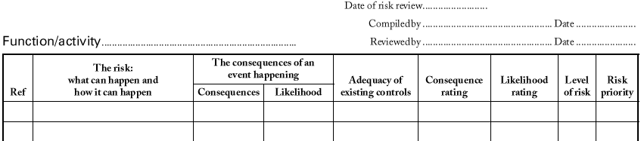
Creating a Risk Register
Create the Risk Register
Record active risks
Assign a unique number to each risk element

Slide 72
Risk Register Risk Management Steps
Identifying the risk
Evaluating the severity of any identified risks
Applying possible solutions to those risks
Monitoring and analyzing the effectiveness of any subsequent steps taken

Slide 73
Botnets
DDoS
Hacking
Malware
Pharming
Phishing
Ransomware
Spam
Spoofing
Spyware
Trojan Horses
Viruses
WiFi Eavesdropping
Worms

